Slide 1
Solving Problem by Searching

Slide 2
Outline
Problem-solving agents
Problem types
Single state (fully observable)
Search with partial information – Tìm kiếm với thông tin không hoàn chỉnh.
Problem formulation – Phát biểu bài toán
Example problems
Basic search algorithms – Các thuật toán tìm kiếm cơ bản
Uninformed search – Tìm kiếm không có thông tin

Slide 3
Problem-solving agent
A kind of goal-based agent
Bốn bước tổng quát trong việc giải quyết bài toán:
Goal formulation
Xác định đích của bài toán (các trạng thái đích)
Problem formulation - Định nghĩa bài toán
Xác định tập các trạng thái có thể (không gian trạng thái)
Xác định tập các hành động có thể
Search – Tìm kiếm lờI giải
Xác định dãy các hành động có thể mà dẫn tới các trạng thái đích và chọn một dãy tốt nhất.
Execute
Thực hiện dãy hành động của lời giải.

Slide 4
Problem-solving agent
Restricted form of general agent:
function SIMPLE-PROBLEM-SOLVING-AGENT(percept) return an action
static: seq, an action sequence, initially empty,
state, some description of the current world state,
goal, a goal, initially null,
problem, a problem formulation
state ← UPDATE-STATE(state, percept)
if seq is empty then
goal ← FORMULATE-GOAL(state)
problem ← FORMULATE-PROBLEM(state, goal)
seq ← SEARCH(problem)
action ← FIRST(seq)
seq ← REST(seq)
return action

Slide 5
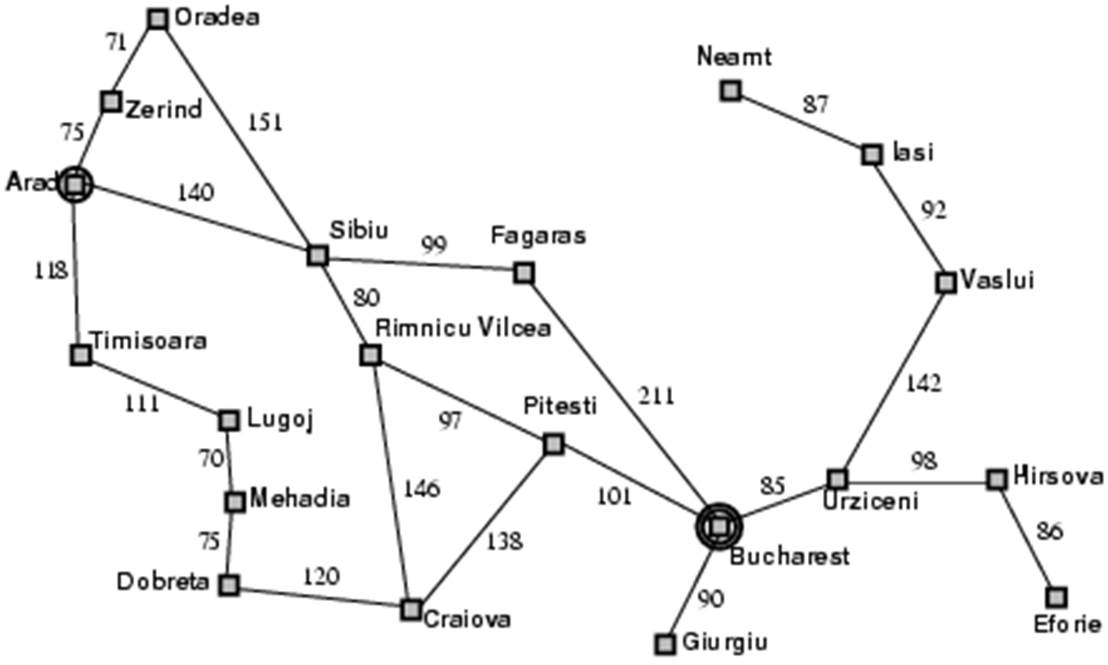
Example: Romania

Slide 6
Example: Romania
On holiday in Romania; currently in Arad
Flight leaves tomorrow from Bucharest
Formulate goal
Be in Bucharest
Formulate problem
States: various cities
Actions: drive between cities
Find solution
Sequence of cities; e.g. Arad, Sibiu, Fagaras, Bucharest, …

Slide 7
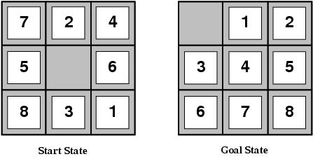
Example: 8-puzzle
Formulate goal: a goal configuration
Formulate problem
States?? Integer location of each tile (9! States)
Actions?? {Left, Right, Up, Down}
Find solution
Sequence of actions to gain the goal state.

Slide 8
Problem types
Deterministic, fully observable ⇒ single state problem
Agent knows exactly which state it will be in after any sequence of actions; solution is a sequence.
Partial knowledge of states and actions:
Non-observable ⇒ sensorless or conformant problem
Agent may have no idea where it is; solution (if any) is a sequence.
Nondeterministic and/or partially observable ⇒ contingency problem
Percepts provide new information about current state; solution is a tree or policy; often interleave search and execution.
Unknown state space ⇒ exploration problem ("online")
When states and actions of the environment are unknown.

Slide 9
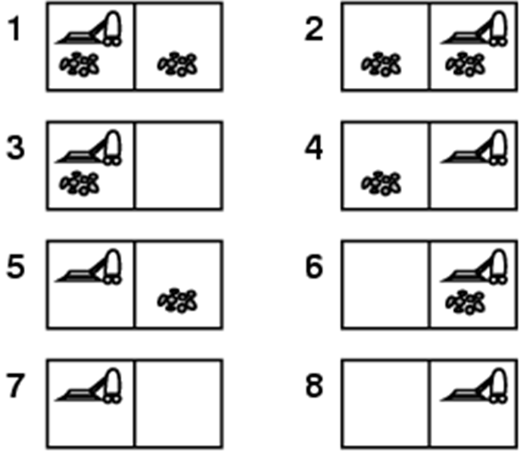
Example: vacuum world single-state
Single-state, start in #5. Solution? [Right, Suck]

Slide 10

Conformant (Sensorless) problems
The agent knows the geography of its world, but doesn't know its location or the distribution of dirt
Start in {1, 2, 3, 4, 5, 6, 7, 8} e.g Right goes to {2, 4, 6, 8}.
Solution??
[Right, Suck, Left, Suck]
When the world is not fully observable: reason about a set of states that migth be reached
=belief state

Slide 11
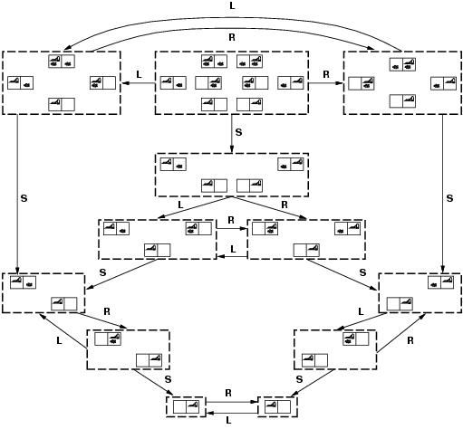
Belief state of vacuum-world

Slide 12
Contingency (ngẫu nhiên) problems
Nondeterministic: assume Murphy’s law, suck can dirty a clean carpet.
Partially observable (local sensing): dirt, location only.
Percept = [L, Dirty] = {1, 3}
[Suck] = {5, 7}
[Right] ={6, 8}
[Suck] in {6}={8} (Success)
BUT [Suck] in {8} = failure
Solution??
Belief-state: no fixed action sequence guarantees solution
Relax requirement:
[Suck, Right, if [R, dirty] then Suck]
Select actions based on contingencies arising during execution.

Slide 13
Single-state problem formulation
A problem is defined by:
An initial state, e.g. Arad
Actions or Successor function S(X) = set of action-state pairs
Tập các trạng thái có thể đạt được từ trạng thái x
e.g. S(Arad) = {<Arad → Zerind, Zerind>,…}
intial state + successor function = state space
Goal test, can be
Explicit, e.g. x = 'at bucharest'
Implicit, e.g. checkmate(x)
Path cost (additive)
e.g. sum of distances, number of actions executed, …
c(x,a,y) is the step cost, assumed to be >= 0
A solution is a sequence of actions from initial to goal state. Optimal solution has the lowest path cost.

Slide 14
Selecting a state space
Real world is absurdly complex.
State space must be abstracted for problem solving.
(Abstract) state = set of real states.
(Abstract) action = complex combination of real actions.
e.g. Arad → Zerind represents a complex set of possible routes, detours, rest stops, etc.
The abstraction is valid if the path between two states is reflected in the real world.
(Abstract) solution = set of real paths that are solutions in the real world.
Each abstract action should be “easier” than the real problem.

Slide 15
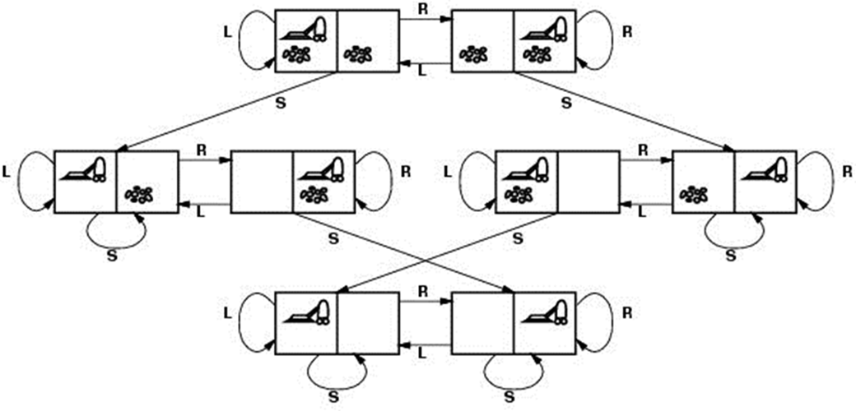
Example: vacuum world
States?? two locations with or without dirt: 2 x 2²=8 states.
Initial state?? Any state can be initial
Actions?? {Left, Right, Suck}
Goal test?? Check whether squares are clean.
Path cost?? Number of actions to reach goal.

Slide 16
Example: 8-puzzle
States?? Integer location of each tile (9! States)
Initial state?? Any state can be initial
Actions?? {Left, Right, Up, Down}
Goal test?? Check whether goal configuration is reached
Path cost?? Number of actions to reach goal

Slide 17
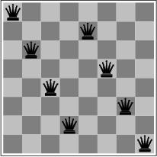
Example: 8-queens problem
States??
Initial state??
Actions??
Goal test??
Path cost??
Incremental formulation vs. complete-state formulation

Slide 18
Example: 8-queens problem
Complete-state formulation
States?? Any arrangement of 0 to 8 queens on the board
Initial state?? No queens
Actions?? Add queen in empty square
Goal test?? 8 queens on board and none attacked
Path cost?? None
≈ 3 x 10¹⁴ possible sequences to investigate

Slide 19
Example: 8-queens problem
Incremental formulation
States?? n (0≤ n≤ 8) queens on the board, one per column in the n leftmost columns with no queen attacking another.
Actions?? Add queen in leftmost empty column such that is not attacking other queens
2057 possible sequences to investigate;

Slide 20
Basic search algorithms
How do we find the solutions of previous problems?
Search the state space (remember complexity of space depends on state representation)
Here: search through explicit tree generation
ROOT = initial state.
Nodes and leafs generated through successor function.
In general search generates a graph (same state through multiple paths)

Slide 21
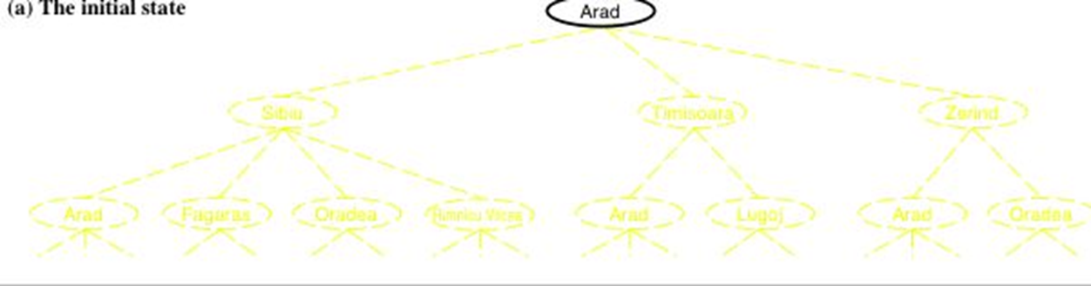
Simple tree search example
function TREE-SEARCH(problem, strategy) return a solution or failure
Initialize search tree to the initial state of the problem
loop do
if no candidates for expansion then return failure
choose leaf node for expansion according to strategy
if node contains goal state then return the corresponding solution
else expand chosen node and add resulting nodes to the search tree
enddo

Slide 22
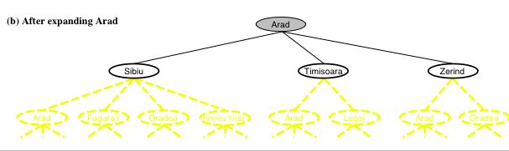
Simple tree search example
function TREE-SEARCH(problem, strategy) return a solution or failure
Initialize search tree to the initial state of the problem
loop do
if no candidates for expansion then return failure
choose leaf node for expansion according to strategy
if node contains goal state then return the corresponding solution
else expand chosen node and add resulting nodes to the search tree
enddo

Slide 23
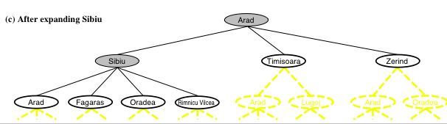
Simple tree search example
function TREE-SEARCH(problem, strategy) return a solution or failure
Initialize search tree to the initial state of the problem
loop do
if no candidates for expansion then return failure
choose leaf node for expansion according to strategy
if node contains goal state then return the corresponding solution
else expand chosen node and add resulting nodes to the search tree
enddo
Determines search process!!

Slide 24
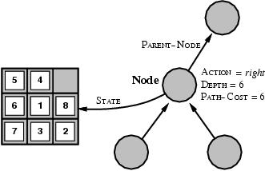
Infrastructure for search algorithms
A state is a (representation of) a physical configuration
A node is a data structure belong to a search tree include state, parent-node, action, path-cost, depth

Slide 25
Tree search algorithm
function TREE-SEARCH(problem) return a solution or failure
frontier ← INSERT(MAKE-NODE(problem.INITIAL-STATE), frontier)
loop do
if EMPTY?(frontier) then return failure
node ← REMOVE-FIRST(frontier)
if problem.GOAL-TEST(node.STATE)
then return SOLUTION(node)
for each action in problem.ACTIONS(node.STATE) do
child ← CHILD-NODE(problem, node, action)
frontier ← INSERT(child, frontier)
frontier = contains generated nodes which are not yet expanded.
White nodes with black outline

Slide 26
Tree search algorithm (con’t)
function CHILD-NODE(problem, parent, action) returns a node
return a node with STATE = problem.RESULT(parent.STATE, action), PARENT = parent,
ACTION = action,
DEPTH = parent.DEPTH + 1 PATH-COST = parent.PATH-COST + problem.STEP-COST(parent.STATE, action)

Slide 27
Search strategies
A strategy is defined by picking the order of node expansion.
Problem-solving performance is measured in four ways:
Completeness : Does it always find a solution if one exists?
Optimality : Does it always find the least-cost solution?
Time Complexity : Number of nodes generated/expanded?
Space Complexity : Number of nodes stored in memory during search?
Time and space complexity are measured in terms of problem difficulty defined by:
b - maximum branching factor of the search tree
d - depth of the least-cost solution
m - maximum depth of the state space (may be ∞)

Slide 28
Uninformed Search Strategies

Slide 29
Uninformed search strategies
(a.k.a. blind search) = use only information available in problem definition.
When strategies can determine whether one non-goal state is better than another → informed search.
Categories defined by expansion algorithm:
Breadth-first search
Uniform-cost search
Depth-first search
Depth-limited search
Iterative deepening search.
Bidirectional search

Slide 30
Breadth-first search
Expand shallowest unexpanded node
Implementation:
frontier is a FIFO queue, i.e., new successors go at end

Slide 31
Breadth-First Search (BFS)
TREE-SEARCH(problem, queue)
S start
# of nodes tested: 0, expanded: 0
current | queue
 | {S}
5
2
4
A
B
C
9
4
6
2
D
E
6
G
goal
1
F
7
H

Slide 32
Breadth-First Search (BFS)
TREE-SEARCH(problem, queue)
S start
# of nodes tested: 1, expanded: 1
current | queue
 | {S}
S not goal | {A,B,C}
5
2
4
A
B
C
9
4
6
2
D
E
6
G
goal
1
F
7
H

Slide 33
Breadth-First Search (BFS)
TREE-SEARCH(problem, queue)
S start
# of nodes tested: 2, expanded: 2
current | queue
 | {S}
S | {A,B,C}
A not goal | {B,C,D,E}
5
2
4
A
B
C
9
4
6
2
D
E
6
G
goal
1
F
7
H

Slide 34
Breadth-First Search (BFS)
TREE-SEARCH(problem, queue)
S start
# of nodes tested: 3, expanded: 3
current | queue
 | {S}
S | {A,B,C}
A | {B,C,D,E}
B not goal | {C,D,E,G}
5
2
4
A
B
C
9
4
6
2
D
E
6
G
goal
1
F
7
H

Slide 35
Breadth-First Search (BFS)
TREE-SEARCH(problem, queue)
S start
# of nodes tested: 4, expanded: 4
current | queue
 | {S}
S | {A,B,C}
A | {B,C,D,E}
B | {C,D,E,G}
C not goal | {D,E,G,F}
5
2
4
A
B
C
9
4
6
2
D
E
6
G
goal
1
F
7
H

Slide 36
Breadth-First Search (BFS)
TREE-SEARCH(problem, queue)
S start
# of nodes tested: 5, expanded: 5
current | Queue.
 | {S}
S | {A,B,C}
A | {B,C,D,E}
B | {C,D,E,G}
C | {D,E,G,F}
D not goal | {E,G,F,H}
5
2
4
A
B
C
9
4
6
2
D
E
6
G
goal
1
F
7
H

Slide 37
Breadth-First Search (BFS)
TREE-SEARCH(problem, queue)
S start
# of nodes tested: 6, expanded: 6
current | queue
 | {S}
S | {A,B,C}
A | {B,C,D,E}
B | {C,D,E,G}
C | {D,E,G,F}
D | {E,G,F,H}
E not goal | {G,F,H,G}
5
2
4
A
B
C
9
4
6
2
D
E
6
G
goal
1
F
7
H

Slide 38
Breadth-First Search (BFS)
TREE-SEARCH(problem, queue)
S start
# of nodes tested: 7, expanded: 6
current | queue
 | {S}
S | {A,B,C}
A | {B,C,D,E}
B | {C,D,E,G}
C | {D,E,G,F}
D | {E,G,F,H}
E | {G,F,H,G}
G goal | {F,H,G} no expand
5
2
4
A
B
C
9
4
6
2
D
E
6
G
goal
1
F
7
H

Slide 39
Breadth-First Search (BFS)
TREE-SEARCH(problem, queue)
S start
# of nodes tested: 7, expanded: 6
current | queue
 | {S}
S | {A,B,C}
A | {B,C,D,E}
B | {C,D,E,G}
C | {D,E,G,F}
D | {E,G,F,H}
E | {G,F,H,G}
G | {F,H,G}
5
2
4
A
B
C
9
4
6
2
D
E
6
G
goal
1
F
7
H
path: S,B,G cost: 8

Slide 40
Properties of breadth-first search
Complete? Yes (if b is finite)
Time? 1+b+b²+b³+… +b^{d} + b(b^{d}-1) = O(b^{d+1})
Space? O(b^{d+1}) (keeps every node in memory)
Optimal? Yes (if cost = 1 per step)
Space is the bigger problem (more than time)

Slide 41
Breadth-First search; evaluation
Two lessons:
Memory requirements are a bigger problem than its execution time.
Exponential complexity search problems cannot be solved by uninformed search methods for any but the smallest instances.
DEPTH | NODES | TIME | MEMORY
2 | 1100 | 0.11 seconds | 1 megabyte
4 | 111100 | 11 seconds | 106 megabytes
6 | 10⁷ | 19 minutes | 10 gigabytes
8 | 10⁹ | 31 hours | 1 terabyte
10 | 10¹¹ | 129 days | 101 terabytes
12 | 10¹³ | 35 years | 10 petabytes
14 | 10¹⁵ | 3523 years | 1 exabyte

Slide 42
Depth-first search
Expand deepest unexpanded node
Implementation:
frontier = LIFO queue (stack), i.e., put successors at front

Slide 43
Depth-First Search (DFS)
TREE-SEARCH(problem, stack)
S start
# of nodes tested: 0, expanded: 0
current | stack
 | {S}
5
2
4
A
B
C
9
4
6
2
D
E
6
G
goal
1
F
7
H

Slide 44
Depth-First Search (DFS)
TREE-SEARCH(problem, stack)
S start
# of nodes tested: 1, expanded: 1
current | stack
 | {S}
S not goal | {A,B,C}
5
2
4
A
B
C
9
4
6
2
D
E
6
G
goal
1
F
7
H

Slide 45
Depth-First Search (DFS)
TREE-SEARCH(problem, stack)
S start
# of nodes tested: 2, expanded: 2
current | stack
 | {S}
S | {A,B,C}
A not goal | {D,E,B,C}
5
2
4
A
B
C
9
4
6
2
D
E
6
G
goal
1
F
7
H

Slide 46
Depth-First Search (DFS)
TREE-SEARCH(problem, stack)
S start
# of nodes tested: 3, expanded: 3
current | stack
 | {S}
S | {A,B,C}
A | {D,E,B,C}
D not goal | {H,E,B,C}
5
2
4
A
B
C
9
4
6
2
D
E
6
G
goal
1
F
7
H

Slide 47
Depth-First Search (DFS)
TREE-SEARCH(problem, stack)
S start
# of nodes tested: 4, expanded: 4
current | stack
 | {S}
S | {A,B,C}
A | {D,E,B,C}
D | {H,E,B,C}
H not goal | {E,B,C}
5
2
4
A
B
C
9
4
6
2
D
E
6
G
goal
1
F
7
H

Slide 48
Depth-First Search (DFS)
TREE-SEARCH(problem, stack)
S start
# of nodes tested: 5, expanded: 5
current | stack
 | {S}
S | {A,B,C}
A | {D,E,B,C}
D | {H,E,B,C}
H | {E,B,C}
E not goal | {G,B,C} backtracked
5
2
4
A
B
C
9
4
6
2
D
E
6
G
goal
1
F
7
H

Slide 49
Depth-First Search (DFS)
TREE-SEARCH(problem, stack)
S start
# of nodes tested: 6, expanded: 5
current | stack
 | {S}
S | {A,B,C}
A | {D,E,B,C}
D | {H,E,B,C}
H | {E,B,C}
E | {G,B,C}
G goal | {B,C} no expand
5
2
4
A
B
C
9
4
6
2
D
E
6
G
goal
1
F
7
H

Slide 50
Depth-First Search (DFS)
TREE-SEARCH(problem, stack)
S start
# of nodes tested: 6, expanded: 5
current | stack
 | {S}
S | {A,B,C}
A | {D,E,B,C}
D | {H,E,B,C}
H | {E,B,C}
E | {G,B,C}
G | {B,C}
5
2
4
A
B
C
9
4
6
2
D
E
6
G
goal
1
F
7
H
path: S,A,E,G cost: 15

Slide 51
Properties of depth-first search
Complete? No: fails in infinite-depth spaces, spaces with loops
Modify to avoid repeated states along path
→ complete in finite spaces
Time? O(b^{m}): terrible if m is much larger than d
but if solutions are dense, may be much faster than breadth-first
Space? O(bm), i.e., linear space!
Optimal? No

Slide 52
Uniform-Cost Search
UCS: uniform-cost search
priority queue used to order nodes, sorted by path cost
let g(n) = cost of path from start node s to current node n
sort nodes by increasing value of g
only uninformed search that worries about costs
Called Dijkstra's Algorithm in algorithms lit.
Similar to Branch and Bound Algorithm in operations research literature

Slide 53
Uniform-cost search
Expand least-cost unexpanded node
Implementation:
frontier = queue ordered by path cost
Equivalent to breadth-first if step costs all equal

Slide 54
Uniform-Cost Search (UCS)
TREE-SEARCH(problem, priorityQueue)
S start
# of nodes tested: 0, expanded: 0
current | priorityQueue
 | {S}
5
2
4
A
B
C
9
4
6
2
D
E
6
G
goal
1
F
7
H

Slide 55
Uniform-Cost Search (UCS)
TREE-SEARCH(problem, priorityQueue)
S start
# of nodes tested: 1, expanded: 1
current | priorityQueue
 | {S:0}
S not goal | {B:2,C:4,A:5}
5
2
4
A
B
C
9
4
6
2
D
E
6
G
goal
1
F
7
H

Slide 56
Uniform-Cost Search (UCS)
TREE-SEARCH(problem, priorityQueue)
S start
# of nodes tested: 2, expanded: 2
current | priorityQueue
 | {S}
S | {B:2,C:4,A:5}
B not goal | {C:4,A:5,G:2+6}
5
2
4
A
B
C
9
4
6
2
D
E
6
G
goal
1
F
7
H

Slide 57
Uniform-Cost Search (UCS)
TREE-SEARCH(problem, priorityQueue)
S start
# of nodes tested: 3, expanded: 3
current | priorityQueue
 | {S}
S | {B:2,C:4,A:5}
B | {C:4,A:5,G:8}
C not goal | {A:5,F:4+2,G:8}
5
2
4
A
B
C
9
4
6
2
D
E
6
G
goal
1
F
7
H

Slide 58
Uniform-Cost Search (UCS)
TREE-SEARCH(problem, priorityQueue)
S start
# of nodes tested: 4, expanded: 4
current | priorityQueue
 | {S}
S | {B:2,C:4,A:5}
B | {C:4,A:5,G:8}
C | {A:5,F:6,G:8}
A not goal | {F:6,G:8,E:5+4, D:5+9}
5
2
4
A
B
C
9
4
6
2
D
E
6
G
goal
1
F
7
H

Slide 59
Uniform-Cost Search (UCS)
TREE-SEARCH(problem, priorityQueue)
S start
# of nodes tested: 5, expanded: 5
current | priorityQueue
 | {S}
S | {B:2,C:4,A:5}
B | {C:4,A:5,G:8}
C | {A:5,F:6,G:8}
A | {F:6,G:8,E:9,D:14}
F not goal | {G:6+1,G:8,E:9,D:14}
5
2
4
A
B
C
9
4
6
2
D
E
6
G
goal
1
F
7
H

Slide 60
Uniform-Cost Search (UCS)
TREE-SEARCH(problem, priorityQueue)
S start
# of nodes tested: 6, expanded: 5
current | priorityQueue
 | {S}
S | {B:2,C:4,A:5}
B | {C:4,A:5,G:8}
C | {A:5,F:6,G:8}
A | {F:6,G:8,E:9,D:14}
F | {G:7,G:8,E:9,D:14}
G goal | {G:8,E:9,D:14} no expand
5
2
4
A
B
C
9
4
6
2
D
E
6
G
goal
1
F
7
H

Slide 61
Uniform-Cost Search (UCS)
TREE-SEARCH(problem, priorityQueue)
S start
# of nodes tested: 6, expanded: 5
current | priorityQueue
 | {S}
S | {B:2,C:4,A:5}
B | {C:4,A:5,G:8}
C | {A:5,F:6,G:8}
A | {F:6,G:8,E:9,D:14}
F | {G:7,G:8,E:9,D:14}
G | {G:8,E:9,D:14}
5
2
4
A
B
C
9
4
6
2
D
E
6
G
goal
1
F
7
H
path: S,C,F,G cost: 7

Slide 62
Evaluating UCS Search Strategies
Characterize UCS in terms of the criteria.
Complete (if b is finite, cost >= e)
Optimal: Yes but
requires the goal test to be applied when a node is removed from the nodes list
rather than when the node is first generated when its parent node is expanded
Time and space complexity: O(b^{d}) Exponential
d is the depth of the solution
b: the branching factor at each non-leaf node and assuming all edges have the same cost

Slide 63
Depth-limited search
Is DF-search with depth limit l.
i.e. nodes at depth l have no successors.
Problem knowledge can be used
Solves the infinite-path problem.
If l < d then incompleteness results.
If l > d then not optimal.
Time complexity: O(b^{l})
Space complexity: O(bl)

Slide 64
Depth-limited algorithm
Recursive implementation:
function DEPTH-LIMITED-SEARCH(problem, limit) return a solution or failure/cutoff
return RECURSIVE-DLS(MAKE-NODE(problem.INITIAL-STATE), problem, limit)
function RECURSIVE-DLS(node, problem, limit) return a solution or failure/cutoff
if problem.GOAL-TEST(node.STATE) then return SOLUTION(node)
else if limit == 0 then return cutoff
else
cutoff_occurred? ← false
for each action in problem.ACTIONS(node.STATE) do
child ← CHILD-NODE(problem, node, action) result ← RECURSIVE-DLS(child, problem, limit - 1)
if result == cutoff then cutoff_occurred? ← true
else if result ≠ failure then return result
if cutoff_occurred? then return cutoff else return failure

Slide 65
Iterative deepening search
What?
A general strategy to find best depth limit L.
Goals is found at depth d, the depth of the shallowest goal-node.
Often used in combination with DF-search
Combines benefits of DF- en BF-search
do DFS to depth 0 treat start node as leaf
do DFS to depth 1 treat all children of the start node as leaves
if no solution found, do DFS to depth 2
repeat by increasing depth until a solution found
Start node is at depth 0

Slide 66
Iterative deepening search (IDS)
function ITERATIVE_DEEPENING_SEARCH(problem) return a solution or failure
inputs: problem
for depth ← 0 to ∞ do
result ← DEPTH-LIMITED_SEARCH(problem, depth)
if result ≠ cuttoff then return result

Slide 67
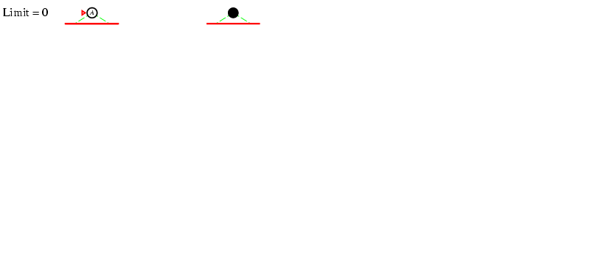
Iterative deepening search L = 0

Slide 68
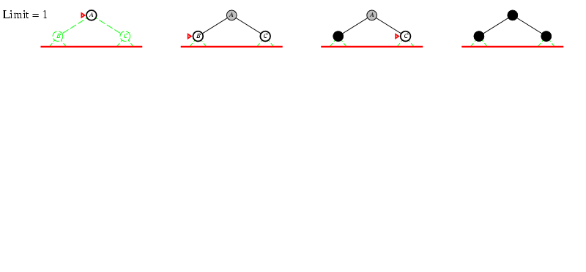
Iterative deepening search L = 1

Slide 69
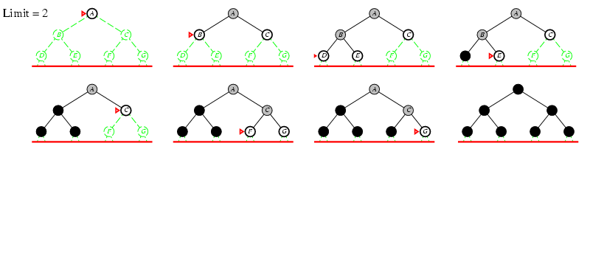
Iterative deepening search L = 2

Slide 70
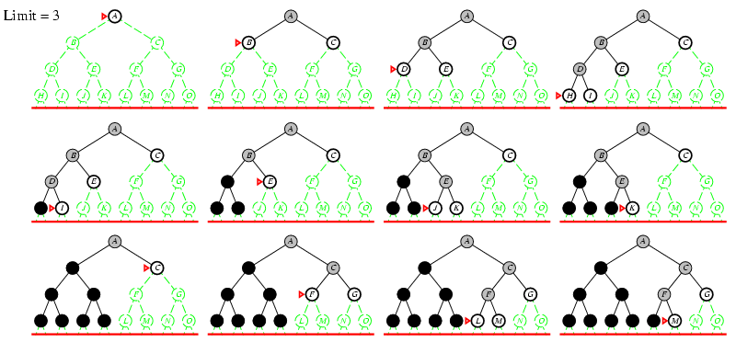
Iterative deepening search L = 3

Slide 71
Iterative-Deepening Search (IDS)
deepeningSearch(problem)
depth: 0, # of nodes tested: 0, expanded: 0
S start
current | nodes list
 | {S}
5
2
4
A
B
C
9
4
6
2
D
E
6
G
goal
1
F
7
H

Slide 72
Iterative-Deepening Search (IDS)
deepeningSearch(problem)
depth: 0, # of nodes tested: 1, expanded: 0
S start
current | nodes list
 | {S}
S not goal | { } @cutoff-FAIL
5
2
4
A
B
C
9
4
6
2
D
E
6
G
goal
1
F
7
H

Slide 73
Iterative-Deepening Search (IDS)
deepeningSearch(problem)
depth: 1, # of nodes tested: 1(1), expanded: 1
S start
current | nodes list
 | {S}
S | { }
S no test | {A,B,C}
5
2
4
A
B
C
9
4
6
2
D
E
6
G
goal
1
F
7
H

Slide 74
Iterative-Deepening Search (IDS)
deepeningSearch(problem)
depth: 1, # of nodes tested: 2(1), expanded: 1
S start
current | nodes list
 | {S}
S | { }
S | {A,B,C}
A not goal | {B,C} @cutoff
5
2
4
A
B
C
9
4
6
2
D
E
6
G
goal
1
F
7
H

Slide 75
Iterative-Deepening Search (IDS)
deepeningSearch(problem)
depth: 1, # of nodes tested: 3(1), expanded: 1
S start
current | nodes list
 | {S}
S | { }
S | {A,B,C}
A | {B,C}
B not goal | {C} @cutoff
5
2
4
A
B
C
9
4
6
2
D
E
6
G
goal
1
F
7
H

Slide 76
Iterative-Deepening Search (IDS)
deepeningSearch(problem)
depth: 1, # of nodes tested: 4(1), expanded: 1
S start
current | nodes list
 | {S}
S | { }
S | {A,B,C}
A | {B,C}
B | {C}
C not goal | { } @cutoff-FAIL
5
2
4
A
B
C
9
4
6
2
D
E
6
G
goal
1
F
7
H

Slide 77
Iterative-Deepening Search (IDS)
deepeningSearch(problem)
depth: 2, # of nodes tested: 4(2), expanded: 2
S start
current | nodes list
 | {S}
S | { }
S | {A,B,C}
A | {B,C}
B | {C}
C | { }
S no test | {A,B,C}
5
2
4
A
B
C
9
4
6
2
D
E
6
G
goal
1
F
7
H

Slide 78
Iterative-Deepening Search (IDS)
deepeningSearch(problem)
depth: 2, # of nodes tested: 4(3), expanded: 3
S start
current | nodes list
 | {S}
S | { }
S | {A,B,C}
A | {B,C}
B | {C}
C | { }
S | {A,B,C}
A no test | {D,E,B,C}
5
2
4
A
B
C
9
4
6
2
D
E
6
G
goal
1
F
7
H

Slide 79
Iterative-Deepening Search (IDS)
deepeningSearch(problem)
depth: 2, # of nodes tested: 5(3), expanded: 3
S start
current | nodes list
 | {S}
S | { }
S | {A,B,C}
A | {B,C}
B | {C}
C | { }
S | {A,B,C}
A | {D,E,B,C}
D not goal | {E,B,C} @cutoff
5
2
4
A
B
C
9
4
6
2
D
E
6
G
goal
1
F
7
H

Slide 80
Iterative-Deepening Search (IDS)
deepeningSearch(problem)
depth: 2, # of nodes tested: 6(3), expanded: 3
S start
current | nodes list
 | {S}
S | { }
S | {A,B,C}
A | {B,C}
B | {C}
C | { }
S | {A,B,C}
A | {D,E,B,C}
D | {E,B,C}
E not goal | {B,C} @cutoff
5
2
4
A
B
C
9
4
6
2
D
E
6
G
goal
1
F
7
H

Slide 81
Iterative-Deepening Search (IDS)
deepeningSearch(problem)
depth: 2, # of nodes tested: 6(4), expanded: 4
S start
current | nodes list
 | {S}
S | { }
S | {A,B,C}
A | {B,C}
B | {C}
C | { }
S | {A,B,C}
A | {D,E,B,C}
D | {E,B,C}
E | {B,C}
B no test | {G,C}
5
2
4
A
B
C
9
4
6
2
D
E
6
G
goal
1
F
7
H

Slide 82
Iterative-Deepening Search (IDS)
deepeningSearch(problem)
depth: 2, # of nodes tested: 7(4), expanded: 4
S start
current | nodes list
 | {S}
S | { }
S | {A,B,C}
A | {B,C}
B | {C}
C | { }
S | {A,B,C}
A | {D,E,B,C}
D | {E,B,C}
E | {B,C}
B | {G,C}
G goal | {C} no expand
5
2
4
A
B
C
9
4
6
2
D
E
6
G
goal
1
F
7
H

Slide 83
Iterative-Deepening Search (IDS)
deepeningSearch(problem)
depth: 2, # of nodes tested: 7(4), expanded: 4
S start
current | nodes list
 | {S}
S | { }
S | {A,B,C}
A | {B,C}
B | {C}
C | { }
S | {A,B,C}
A | {D,E,B,C}
D | {E,B,C}
E | {B,C}
B | {G,C}
G | {C}
5
2
4
A
B
C
9
4
6
2
D
E
6
G
goal
1
F
7
H
path: S,B,G cost: 8

Slide 84
Iterative-Deepening Search (IDS)
Has advantages of BFS
completeness
optimality as stated for BFS
Has advantages of DFS
limited space
in practice, even with redundant effort it still finds longer paths faster than BFS!
In general, IDS is the preferred uniformed search strategy for large search spaces when the solution’s depth is unknown.

Slide 85
Iterative-Deepening Search (IDS)
Space complexity: O(bd) linear like DFS
Time complexity depends on the branching factor with
worst case time complexity: O(b^{d}) exponential
redundant effort because nodes near the top of the search tree are generated multiple times
but, majority of nodes are at bottom level of the tree for large branching factor

Slide 86
Iterative-Deepening Search (IDS)
How much redundant effort is done?
number of times the nodes are goal tested: d*b + (d-1)*b² + ... + 2*b^{(d-1)} + 1*b^{d} <= b^{d} / (1 – 1/b)² = O(b^{d})
d: the solution's depth
b: the branching factor at each non-leaf node
For example: b = 4
4^{d} / (1 – ¼)² = 4^{d} / (.75)² = 1.78 * 4^{d}
in the worst case, 78% more nodes are tested (redundant effort) than exist at depth d
as b increases, this % decreases b of 10 is ~23% more tests, 100 is ~2%

Slide 87
Iterative-Deepening Search (IDS)
How much redundant effort is done?
number of nodes generated:
N_{IDS} = d*b + (d-1)*b² + ... + 2*b^{(d-1)} + 1*b^{d}
N_{BFS} = b + b² + ... + b^{(d-1)} + b^{d} + (b^{d+1} – b)
d: the solution's depth
b: the branching factor at each non-leaf node
For example: b = 10, d= 5, goal farthest right
N_{IDS} = 50 + 400 + 3000 + 20000 + 100000 = 123,450
N_{BFS} = 10 + 100 + 1000 + 10000 + 100000 + 999,990 = 1,111,100
worst case IDS is substantially faster than BFS!
Notes:
IDS generally expands fewer nodes than BFS on the same search space

Slide 88
Iterative deepening search
Number of nodes generated in a depth-limited search to depth d with branching factor b:
N_{DLS} = b⁰ + b¹ + b² + … + b^{d-2} + b^{d-1} + b^{d}
Number of nodes generated in an iterative deepening search to depth d with branching factor b:
N_{IDS} = (d+1)b⁰ + d b¹ + (d-1)b² + … + 3b^{d-2} +2b^{d-1} + 1b^{d}
For b = 10, d = 5,
N_{DLS} = 1 + 10 + 100 + 1,000 + 10,000 + 100,000 = 111,111
N_{IDS} = 6 + 50 + 400 + 3,000 + 20,000 + 100,000 = 123,456
Overhead = (123,456 - 111,111)/111,111 = 11%

Slide 89
Properties of iterative deepening search
Complete? Yes
Time? (d+1)b⁰ + d b¹ + (d-1)b² + … + b^{d} = O(b^{d})
Space? O(bd)
Optimal? Yes, if step cost = 1

Slide 90
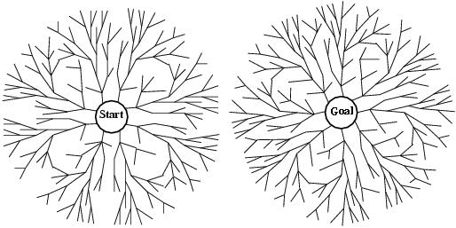
Bidirectional search
Two simultaneous searches from start an goal.
Motivation: b^{d/2}+ b^{d/2} ≠ b^{d}
Check whether the node belongs to the other frontier before expansion.
Space complexity is the most significant weakness.
Complete and optimal if both searches are BF.

Slide 91
How to search backwards?
The predecessor of each node should be efficiently computable.
When actions are easily reversible.

Slide 92
Summary of algorithms
Criterion | Breadth-First | Uniform-cost | Depth-First | Depth-limited | Iterative deepening | Bidirectional search
Complete? | YES* | YES* | NO | YES, if l ≥ d | YES | YES*
Time | b^{d+1} | b^{C*/e} | b^{m} | b^{l} | b^{d} | b^{d/2}
Space | b^{d+1} | b^{C*/e} | bm | bl | bd | b^{d/2}
Optimal? | YES* | YES* | NO | NO | YES | YES

Slide 93
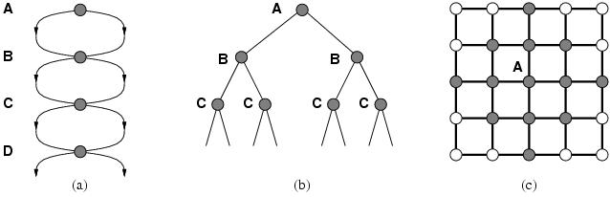
Repeated states
Failure to detect repeated states can turn a solvable problems into unsolvable ones.

Slide 94
Graph search algorithm
function GRAPH-SEARCH(prohdeml returns a solution. or failure
initialize the frontier using the initial stale of problem
initialize the closed set to be empty loop do
if the frontier is empty then return failure
choose a leaf node and remove it from the frontier
if the node contains a goal state then return the corresponding solution
add the node to the closed set
expand the chosen node, adding the resulting nodes to the frontier only if not in the frontier or closed set
frontier contains generated nodes which are not yet expanded.
closed list stores all expanded nodes

Slide 95
Graph search algorithm
function GRAPH-SEARCH(problem) return a solution or failure
closed ← an empty set
frontier ← INSERT(MAKE-NODE(problem.INITIAL-STATE), frontier)
loop do
if EMPTY?(frontier) then return failure
node ← REMOVE-FIRST(frontier)
if problem.GOAL-TEST(node.STATE) then return SOLUTION(node)
add node.STATE to closed
for each action in problem.ACTIONS(node.STATE) do
child ← CHILD-NODE(problem, node, action)
if child.STATE is not in closed or frontier then
frontier ← INSERT(child, frontier)
Closed list stores all expanded nodes

Slide 96
Graph search, evaluation
Optimality:
GRAPH-SEARCH discard newly discovered paths.
This may result in a sub-optimal solution
YET: when uniform-cost search or BF-search with constant step cost
Time and space complexity,
proportional to the size of the state space (may be much smaller than O(bd)).
DF- and ID-search with closed list no longer has linear space requirements since all nodes are stored in closed list!!

Slide 97
Summary
Problem formulation usually requires abstracting away real-world details to define a state space that can feasibly be explored
Variety of uninformed search strategies
Iterative deepening search uses only linear space and not much more time than other uninformed algorithms

